Slide 1
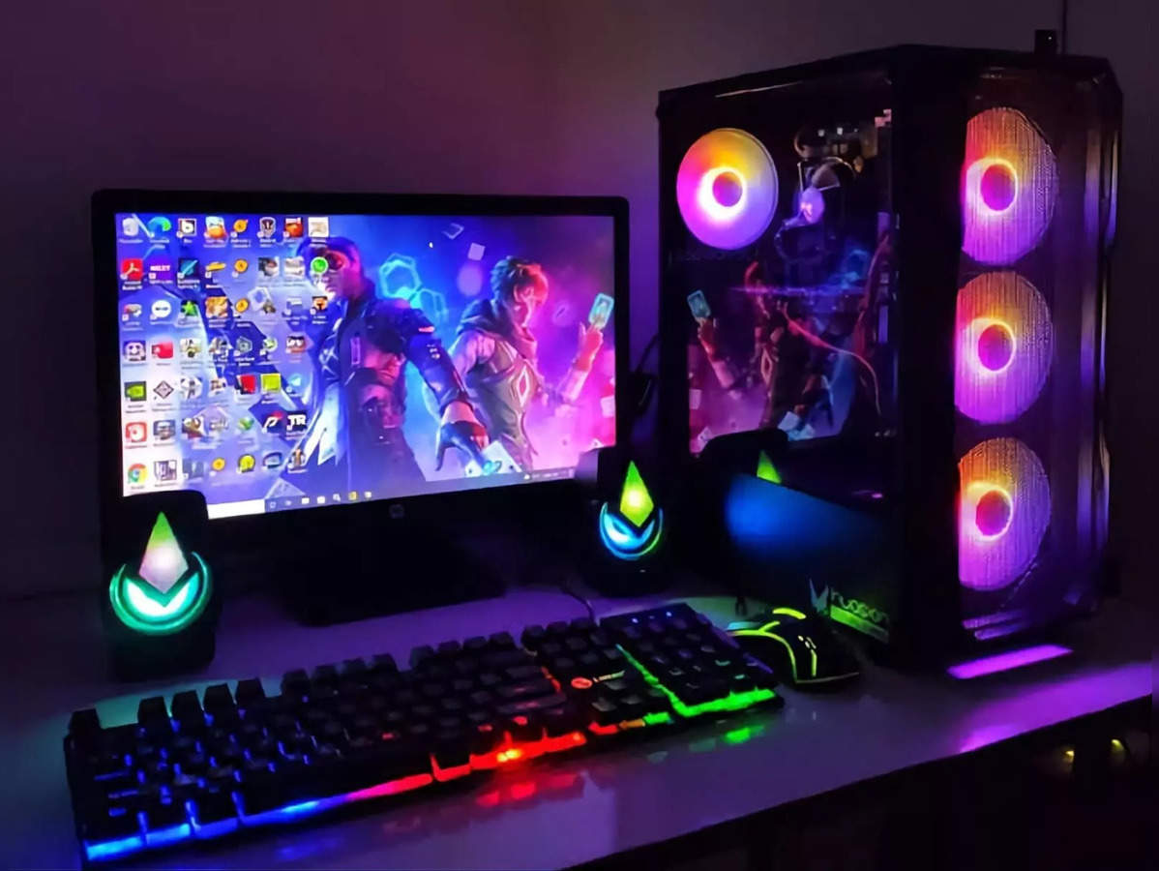

COMPUTER

Slide 2
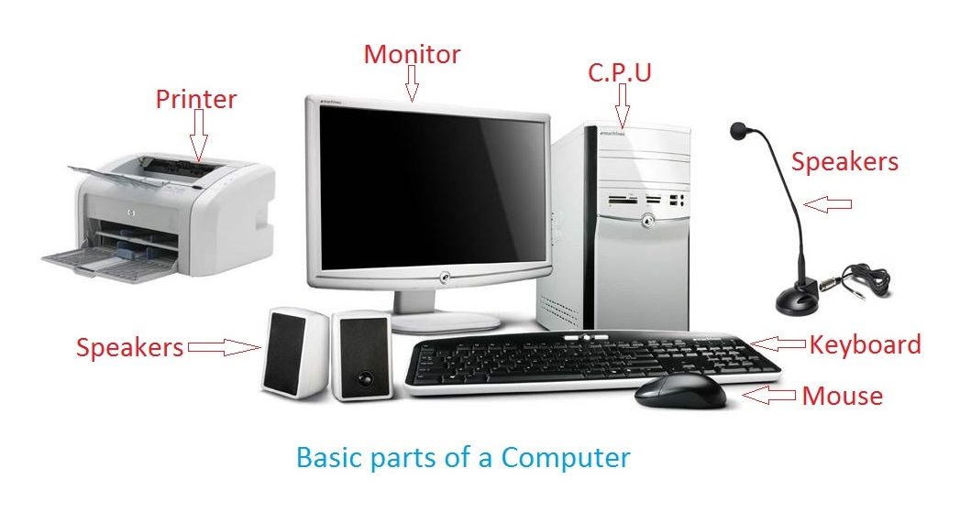
PARTS OF COMPUTER

Slide 3
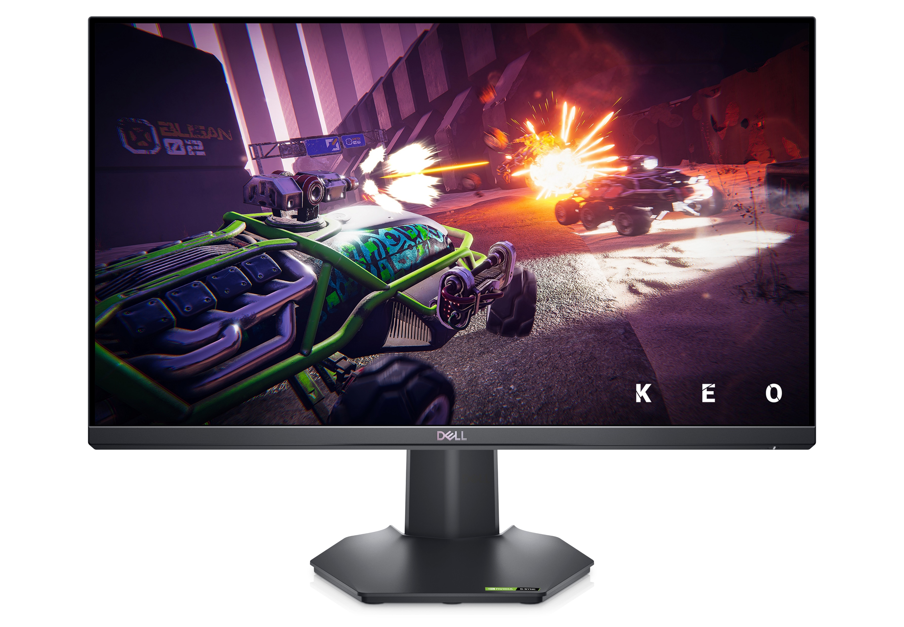
MONITOR

Slide 4
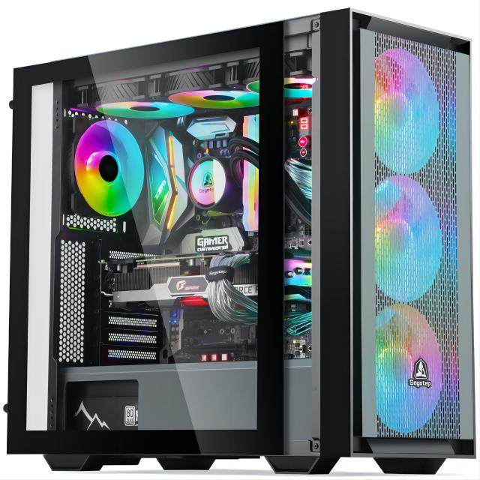
C.P.U

Slide 5
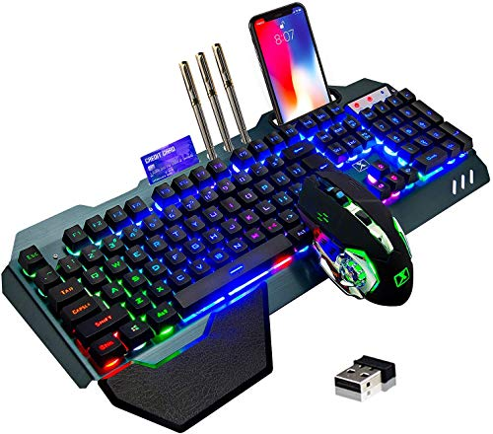
KEYBOARD

Slide 6

MOUSE

Slide 7
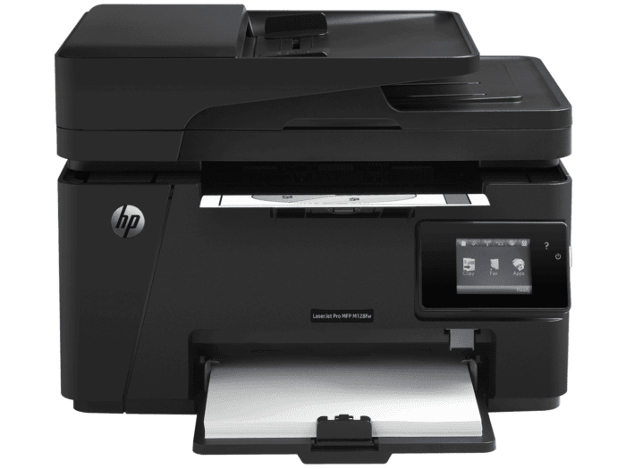
PRINTER

Slide 8
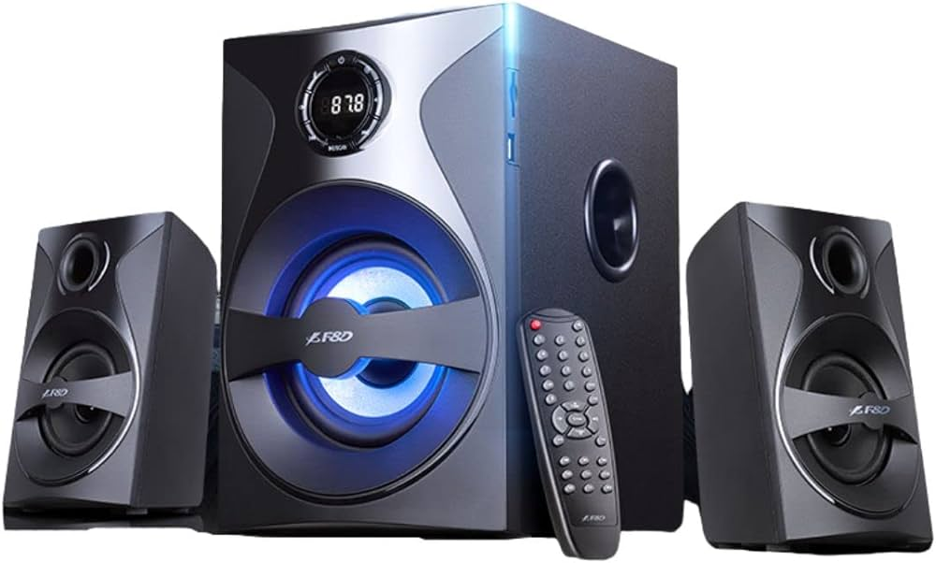
SPEAKERS

Slide 9
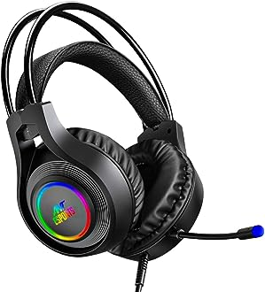
HEADPHONE

